Slide 1

Presentations
Tutor*in:
Notes:
To You: For an abbreviated version, the videos can be omitted, assigned as homework, or only one of the two can be watched. The content of the videos can also be presented summarized with text slides. It is also possible to adjust the work phases of the PowerPoint karaoke, i.e. to give shorter preparation or presentation time.
Relevance of the topic to the Leuphana Semester:
Group presentation in the methods seminar
Group presentation during the conference week (= responsibility module), in one of two defined formats.

Slide 2
Agenda
Structuring a presentation
Present successfully
  AHA-Effect
  Four Steps for a Killer Introduction
  Present as a group
How to Avoid Death by PowerPoint
PowerPoint-Karaoke

Slide 3
Structuring a presentation
What is the goal of the presentation?
What are the main points?
Who is the target group?
How can the concern be illustrated?
What queries may arise?
What technical means do we need?
Notes:
To the students: Before starting with preparing the actual presentation and opening the PowerPoint, you should think about a few important aspects. They will help you to improve your presentation:
What is the goal of the presentation?
Here you agree on a key argument, your core message. You must keep this in mind for all further steps so that you don‘t get lost in between.
Following on from that, what are your main points?
Here you select the statements, facts and points that best underscore your key argument and make it understandable. Agree on a sensible sequence that has a common thread and leads to your core message. Go into depth rather than breadth. Don‘t get lost in details or examples, but stick to your intended goal.
Who is our target group?
Think about the size of your audience and what their expectations are. What interests them?, What is their level of knowledge about your core message? How much do you need to explain, and what can you assume they know? What technical terms may need to be explained or paraphrased?
Use the SIE-formula: Situation of the listeners, Interests of the listeners, and Attitudes of the listeners
How can we illustrate our concern?
A good presentation is not only pure text. Consider what visual aids and graphics are useful to present your topic. They should not be overused and integrated in the moderation.
What queries may arise?
Be prepared for questions. Agree on who can best answer which topic, or wether there is a selected spokesperson. It can be useful to appoint a moderator who opens the Q&A session and directly calls on the questioners.
Ask each other as critical questions as possible in advance and try to paraphrase difficult parts.
What technical means do we need?
So that nothing goes wrong at the moment of the presentation, you should also take a look at your technology. Which format is needed, is an adapter for the beamer available? If you need sound, can you use the room technology for it, or do you still need external devices?

Slide 4
Presenting successfully
AHA-Effect
Beginning Occasion, agenda, goal; arouses interest
Main Body Clear chain of reasoning leading to the key message
Occasional summaries
Examples from the target group
Conclusion Take up and answer initial thesis
Future outlook, opportunities or challenges
Notes:
To the students: AHA effect comes from the German equivalent Anfang Hauptteil Abschluss – I couldn‘t think of a smooth English translation, maybe you can?
Beginning: a good beginning informs about occasion, agenda, goal of presentation; good to solve via initial question; motivates to listen
Main part: clearly structured, comprehensible chain of arguments leads audience through the main part - red thread! - occasional summaries of the most important arguments - include examples in the sense of the target group
Conclusion: is most likely to be remembered, therefore formulate particularly well and use a strong speaker. Pick up on the initial thesis and answer it; outlook on the future can stimulate discussion. It is better to shorten the main part than to omit the quintessence of the conclusion!
Based on this process, when would you use strong speakers, when would you use weak speakers? why?

Slide 5
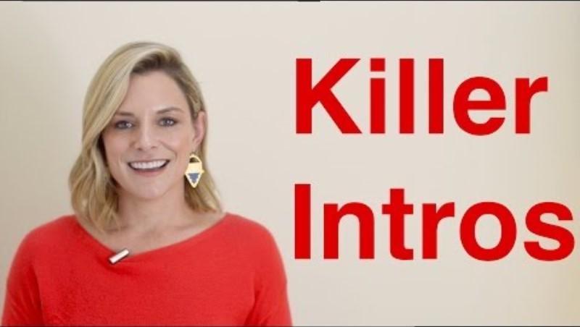
Present successfully
Four Steps for a Killer Introduction
Notes:
To the students: Anne Ricketts now tells us how to make an introduction as meaningful as possible to have the audience right there at the beginning.
[Video, 10min| Link, in case the video is no longer embedded correctly: https://www.youtube.com/watch?v=aGEFtRwPhE4&t=61s

Slide 6
Presenting successfully
Four Steps for a Killer Introduction – Summary
Step 1 - The hook (1:35)
Step 2 - The transition (1:49)
Step 3 - Self-introduction (2:06)
Step 4 - Audience benefit (2:28)
Notes:
To you: You can either use this slide to summarize the content if you don't want to watch the video during the lesson. Or simply hand it out as a note for the students to look up later. Below is a more detailed summary of the video so that you can explain the individual points:

Slide 7
Presenting successfully
Function as a group
Consider the standing positions
distribute tasks
Practice cue-to-cue
ineffective effective
No transitions New speaker briefly summarizes previous speaker, then leads over to themselves
Pure introduction Ask a question, which the next speaker answers
Repeat what was said before
Notes:
To the students:
When several people are presenting, the transitions to each other need special attention. If they do not work, the presentation can be very confusing.
Clarify in advance who will take over which part. Make sure that stronger speakers take over the beginning and the end, as these parts are most likely to be remembered. More experienced speakers will speak in the middle part. Clarify accordingly who is in which position. Distributes duties as to who will organize/bring technology and prepare presentation. Practice the presentation cue-to-cue as needed to know the exact beginnings and endings of your speakers.
Meanwhile: It is very important how you transition to each other. You need to know the content of the speaker you are leading to.
what is not helpful is to completely omit a transition. Also, don’t just introduce them like, "And now Sandra will speak." As a follow-up speaker, don’t simply repeat what was said before and begin your topic incoherently.
Instead, you can briefly summarize the previous speaker, and then link to your field. Or you can ask a question or an open problem about the next subfield, which the next speaker can answer.
you do not have to introduce the next person by name, but it is possible.
make sure that you are also physically in focus. If you’re not the focus yet, don’t speak yet. Don’t leave the stage empty.

Slide 8
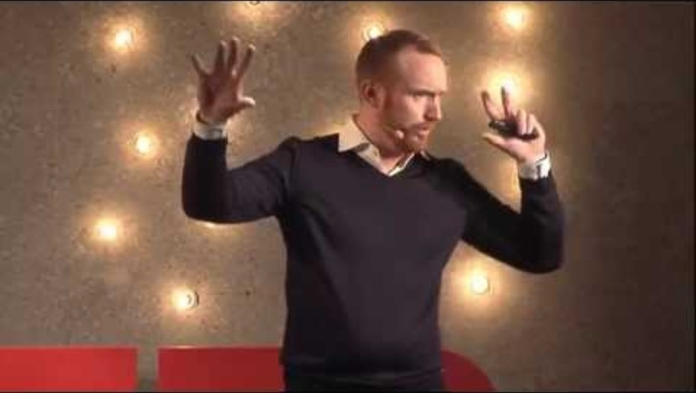
How to Avoid Death by PowerPoint
Notes:
To You: [Video, 20min, link in case the video is no longer embedded correctly: https://www.youtube.com/watch?v=Iwpi1Lm6dFo
For a presentation, visual support is also used in most cases. PowerPoints are omnipresent and therefore require special attention. Of course, the first step of a presentation should be to ask if and which medium is needed at all. Posters or a panel discussion are also valid means. The form of presentation should correspond to the nature of the project.
If you decide to use the classic PowerPoint, it’s worth putting some effort into it as well. In the following video, David JP Phillips shows us which visual rules we should pay attention to so that our audience is not overwhelmed from the first second.

Slide 9
How to Avoid Death by PowerPoint - Summary
One statement per page!
Only use concise text and one image on slides to avoid the ‘redundancy effect’.
The largest / most eye-catching parts of the slides should be the most important parts of your presentation.
Use contrasts to direct the attention of your audience, i.e. emphasize the current text. Use dark backgrounds and light-colored text.
Maximum 6 objects per slide. Rather use more slides with fewer objects per slide!
Notes:
To you: You can either use this slide to summarise the content if you don't want to watch the video during the lesson. Or simply hand it out as a note for the students to look up later. Below is a more detailed summary of the video so that you can explain the individual points:
1. One message per slide!
2. "Redundancy Effect": If what you're saying (verbal script) is also written on your slides, your audience will get 0 info. --> Instead only put short, sweet bit of text and an image.
3. Your eyes focus on moving objects, signaling colours (red/orange/yellow), contrasting objects, and big objects. Slide title is often the biggest object, but rarely the more important. --> The biggest parts of your slides should be the most important part of your presentation.
4. U S E C O N T R A S T to control your audience's attention, i.e. highlight the current text and blend out the other text. + Don't use light backgrounds. Use dark backgrounds and light text! Light background steal too much attention (e.g., from the speaker).
5. Your brain needs to "count" if there are 7 or more objects, but not if there are only 6 or fewer. Your brain can simply "see" the 6 objects. Counting takes 500% more cognitive resources than just seeing. --> The magic number is max 6 objects per slide. The number of slides is rarely the problem. The problem is often the number of objects per slide. --> have more slides with fewer objects per slide!

Slide 10

PowerPoint
"Dieses Foto" von Unbekannter Autor ist lizenziert gemäß CC BY
Notes:
And now: PowerPoint Karaoke - Having learned how to make a really good presentation, they now make the complete opposite.
10 minutes to create presentations in small groups (or pairs, watch for even numbers!) that violate all of these rules.
The content is completely irrelevant and can be combined incoherently. - Depending on when the session is made, for example, a Christmas theme lends itself.
The goal: afterwards, fellow students present this presentation without preparation.
They should pay attention to appropriate introductions and transitions. The PowerPoint presentation ends as soon as all slides are over, or after 6 minutes at the latest.

